Slide 1
Southwestern Community College Nursing Assistant Career Presentation
Presented By:
Donna Conner, RN
February 2020

Slide 2
Why become a Nursing Assistant?

Slide 3
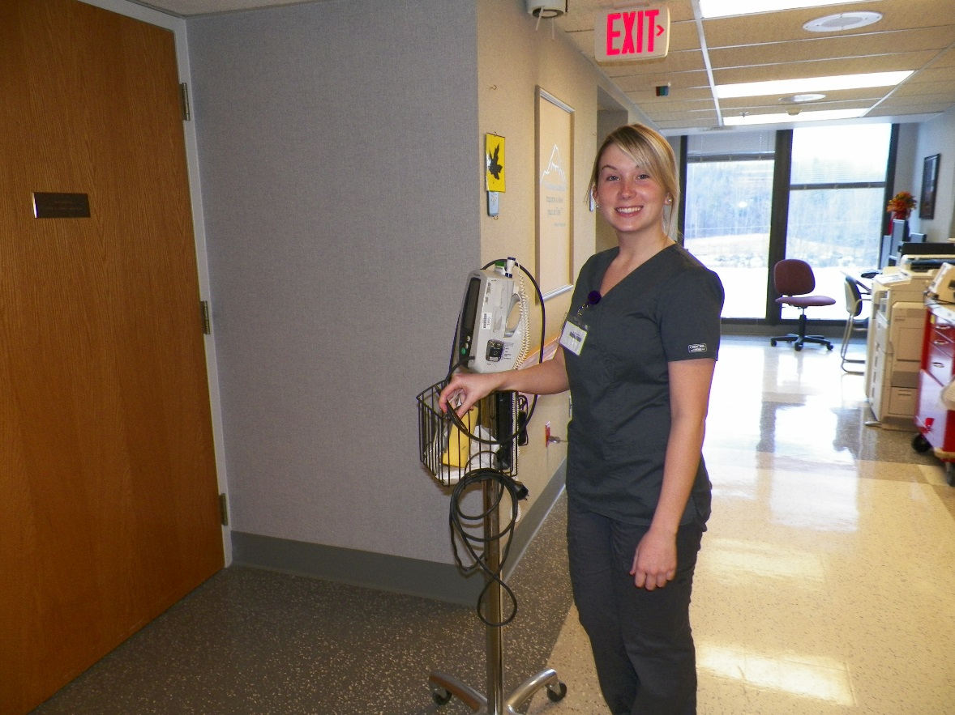
Definition of Nursing Assistant
A valued, unlicensed member of the healthcare team responsible for providing delegated nursing tasks, within a defined range of function, for residents in a variety of settings and who is listed on the NC Nurse Aide I Registry.
(State of North Carolina, 2013)

Slide 4
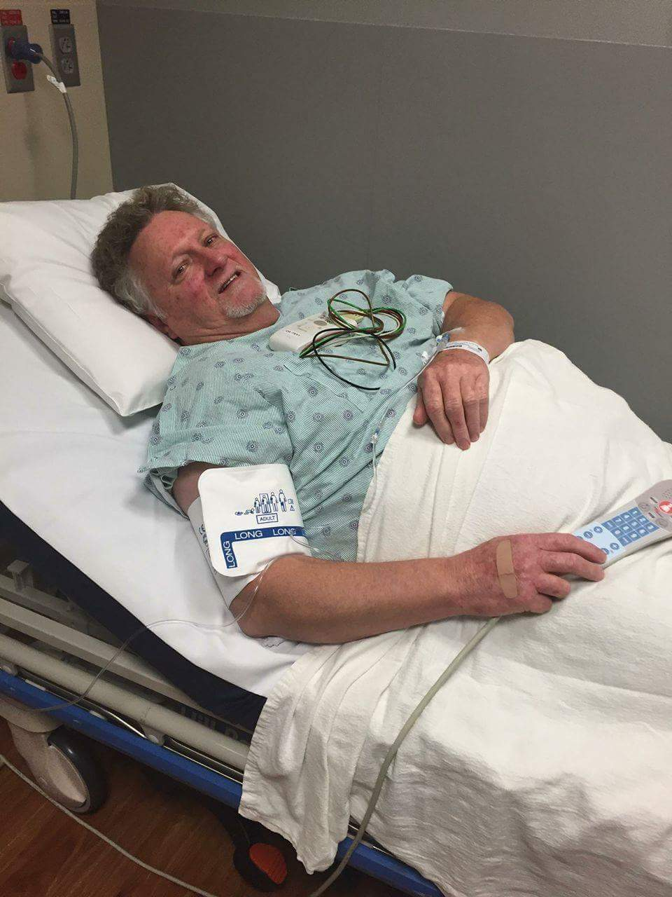
Nursing Assistant’s Role
Assists patients with:
Bathing, Shaving
Dressing, Meals
Mouth and Hair Care
Bedpan or Urinal
Positioning
Obtaining Vital Signs
Ambulating
Nursing Assistants report to the Registered Nurse

Slide 5
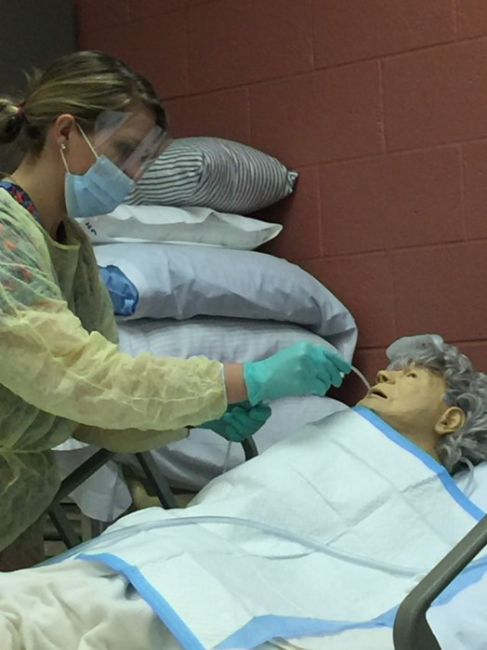
Nursing Assistant II’s Role
Performs:
Insertion of a Foley Catheter
Feeding a patient via a Feeding Tube
Prime IV tubing and monitoring of IV site
Suctioning
Set-up Oxygen
Ostomy Care
Perform Fecal Disimpaction
Blood Glucose Monitoring
The Nursing Assistant II also reports to the
Registered Nurse

Slide 6
Geriatric Aide
Provides Nurse Aide I with skills needed to provide specialized care for our aging population
Emphasis is placed on person-centered care, stress management, health promotion, dementia/ challenging behaviors, mental health issues and end of life/palliative care
Successful candidates are eligible to be listed on the North Carolina Geriatric Nurse Aide Registry

Slide 7
Medication Aide
Teaches safe & effective medication delivery skills to the Nurse Aide I
Focus is placed on the six rights of medication administration
Upon completion, students will be eligible to take the North Carolina Medication Aide test and be listed on the North Carolina Medication Aide Registry

Slide 8
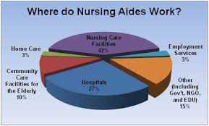
Nursing Assistant Work Settings
Hospitals
Long-term Care Facilities
Doctor Offices
Ambulatory Care Centers
Camps
Homeless Shelters
Home Health
Prisons
Cruises
Private Care

Slide 9
Nurse Aide Salary

Slide 10
What Programs are Available?

Slide 11
Nursing Assistant
Certificate Program
Fall Semester
NAS 101-Nursing Assistant I
Spring Semester
NAS 102-Nursing Assistant II
NAS 106-Geriatric Aide
OR
MED 121-Medical Terminology I
AND
MED 122-Medical Terminology II
*Additional classes available through Continuing Education*

Slide 12
IN ANY ROLE IN HEALTHCARE
Be sure you care!!
It’s not about the $$, it’s about caring for your patients and helping when they need you most.

